Slide 1

Predator-prey models, limit cycles, Hopf bifurcation
vincent.jansen@rhul.ac.uk

Slide 2
Outline
Trophic interactions
D’Ancona’s observation & Volterra predator-prey model
The Rosenzweig-MacArthur model
Stable limit cycles, the paradox of enrichment
Parasitism, the Nicholson Bailey model
Spatial interactions

Slide 3
Trophic interactions
Trophic interactions capture all interactions where one species uses another species to feed and reproduce on.
This includes predation, herbivory and parasitism.

Slide 4
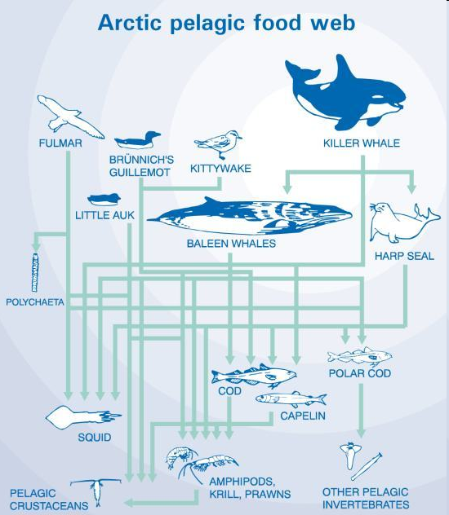
Trophic interactions
Trophic interactions are conspicuous
They are fairly easy to detect and quantify (gut contents)
They are therefore probably over-represented in ecological studies compared to competitive interactions
Food web theory is almost exclusively dedicated to trophic interactions, competition in food webs is rarely measured

Slide 5
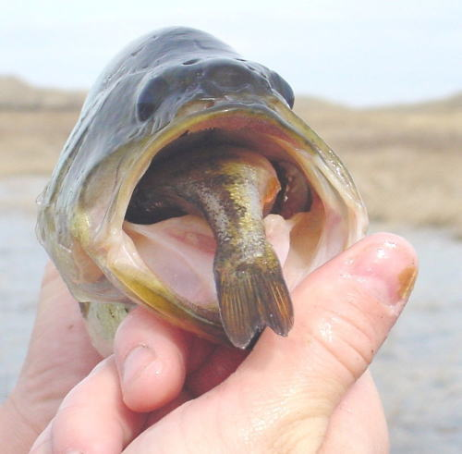
D’Ancona’s observation

Slide 6
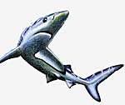
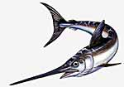
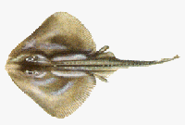
D’Ancona’s observation
Umberto D’Ancona studied data of the Adriatic fisheries
During the first world war (1914-1918) the fishery effort in the Adriatic had been much reduced

Slide 7
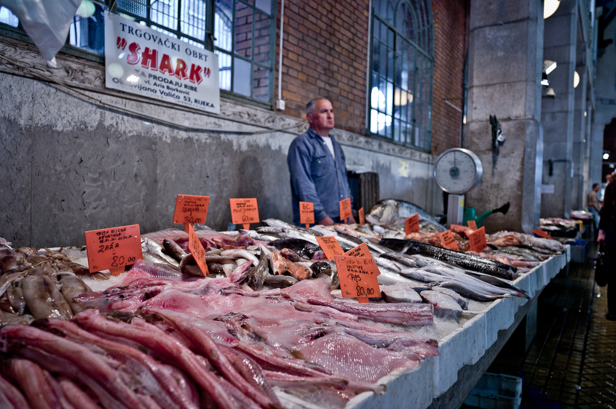
Fiume (Riyeka) fishmarket

Slide 9
D’Ancona’s observation
He noticed that the proportion of predatory fish (sharks, skates, rays etc.) had increased.
Fishermen concentrate on prey fish.
Why the increase?

Slide 10
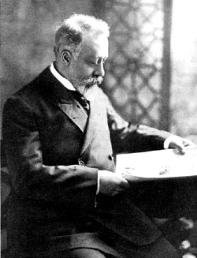
D’Ancona’s observation
This is puzzling as fishermen prefer to catch prey fish.
D’Ancona asked his fiancee’s father, Vito Volterra, how this could be explained.
Vito Volterra was a theoretical
physicist who was developing
an interest in biology.
Vito Volterra
(1860-1940)

Slide 11
Lotka-Volterra predator-prey model
Volterra produced a model (Alfred Lotka produced a similar model at about the same time)
The model is similar in structure to the L-V competition model. In the competition model both species suffer from each others presence (--) in this model the prey suffers, the predator benefits (-+)

Slide 12
Predators and their prey
Volterra assumed:
Without predators the prey population grows unbounded, no density dependence
Without prey the predator population disappears
The number of prey caught only depends on encounter probabilities

Slide 13
Lotka-Volterra predator-prey model
We will use a slightly different notation (following Gotelli)
V: density of the prey (victim) population
P: density of the predator population
In the absence of the predator the prey grows exponentially

Slide 14
Lotka-Volterra predator-prey model
Functional response: the per predator effect of predation on the prey’s growth rate
α is the capture efficiency, assumed to be constant
The functional response is αV
The prey’s growth rate is:

Slide 15
Lotka-Volterra predator-prey model
The per capita prey growth rate is
The per capita prey growth rate is independent of prey density
If the predator density is low, the prey population increases, if it is high it decreases

Slide 16
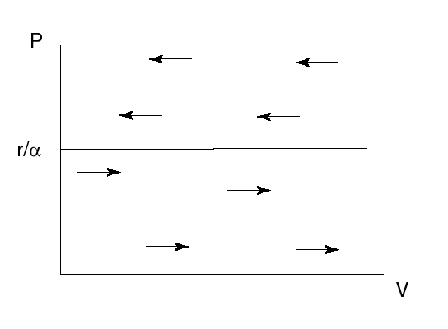
Lotka-Volterra predator-prey model
Prey dynamics if predator density is constant

Slide 17
Lotka-Volterra predator-prey model
In the absence of the prey the predator population will decrease
The predator’s death rate is q
In the absence of prey, the predator population changes as:

Slide 18
Lotka-Volterra predator-prey model
β is the amount of energy gained per unit of time. (If e is the conversion efficiency, β=eα)
The numerical response is βV
The predator’s growth rate is

Slide 19
Lotka-Volterra predator-prey model
The per capita predator growth rate is
The per capita predator growth rate is independent of predator density
If the prey density is low, the predator population decreases, if it is high it increases

Slide 20
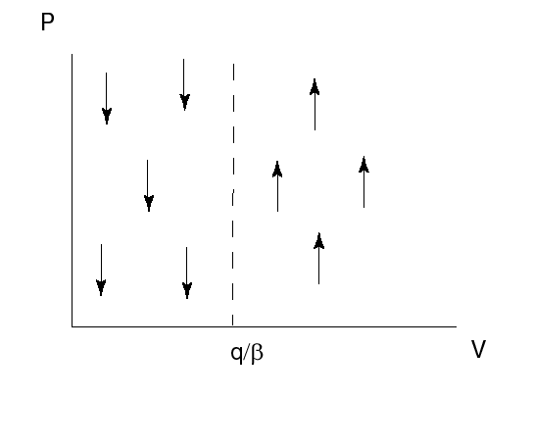
Lotka-Volterra predator-prey model
Predator dynamics if prey density is constant

Slide 21
Lotka-Volterra predator-prey model
The densities of predator and prey change simultaneously
This is described by a system of 2 differential equations:
This model is known as the Lotka-Volterra predator-prey model

Slide 22
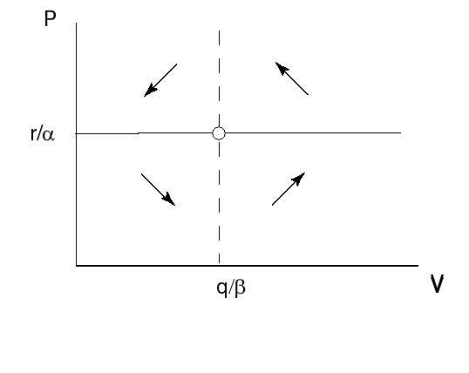
Lotka-Volterra predator-prey model
Combined isoclines

Slide 23
Lotka-Volterra predator-prey model
The prey equilibrium density is given by q/β: only depends on the parameters relating to the predator.
The predator equilibrium density is given by r/α only depends on the parameters relating to the prey.

Slide 24
Lotka-Volterra predator-prey model with fishery effort
If we assume that fish is caught with rate f, the model reads:
The prey equibrium is now V*=(q+f)/β
The predator equilibrium is now P*=(r-f)/α

Slide 25
Lotka-Volterra predator-prey model
A reduced fishing effort (directed at prey and predatory fish) will have two effects: it increases the predator’s equilibrium density and decreases the prey’s equilibrium density
This can explain D’Ancona’s observation why relatively more predator fish was caught after a reduced fishing effort

Slide 26
Lotka-Volterra predator-prey model, dynamics
Combined isoclines

Slide 27
Practical 3: The Lotka-Volterra predator-prey model

Slide 28
Lotka-Volterra predator-prey model
The solutions oscillate over time, the amplitude depends on the initial condition much like the motion of a pendulum
Solution over time

Slide 29


Slide 30
Lotka-Volterra predator-prey model
r/α
q/β
Solution as an orbit in a phase plot

Slide 31
Stability
To find the stability we use the distance from the equilibrium x=V-V* and y=P-P* linearise the system, to find

Slide 32
Stability
After substituting the equilibrium values we find that the Jacobian matrix is
Is the equilibrium stable?

Slide 33
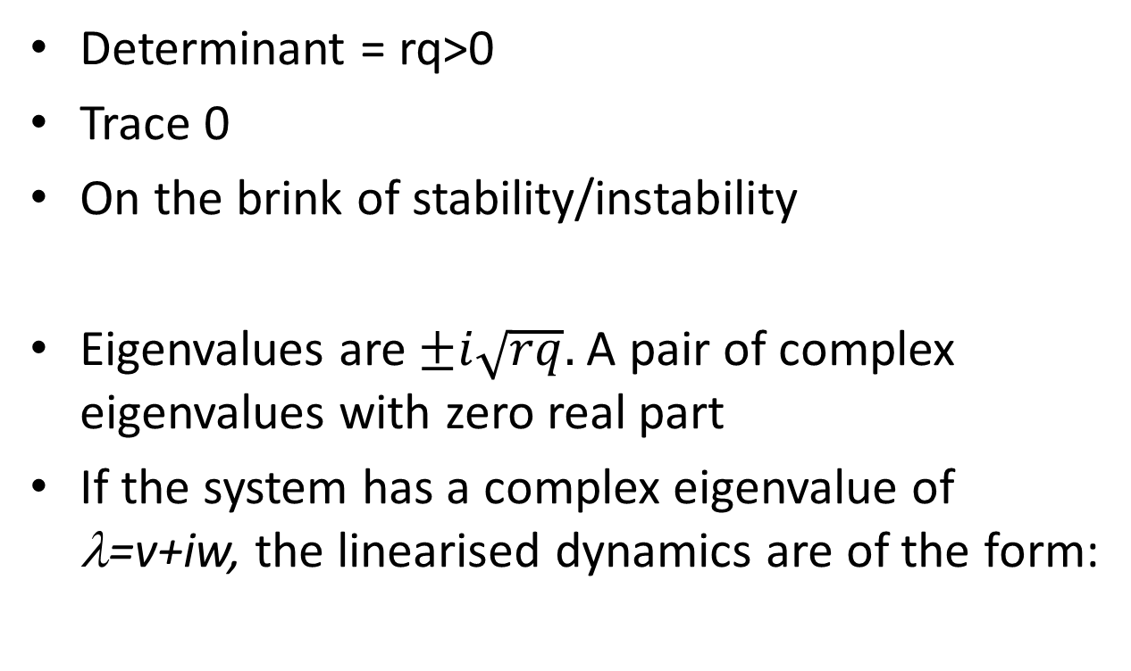
Stability

Slide 34
Oscillation frequency
The period of the unforced system follows from the eigenvalue.
If the system has a complex eigenvalue of λ=v+iw, the linearised dynamics are of the form:
The frequency of the dynamics is therefore w and the period 2π/w

Slide 35
Stability
The model has a constant of motion:
Over one cycle, the value of H is constant.
If the starting point moves away from one cycle, after on revolution you are back to where you started, you remain the same distance from the other cycle
The cycles are therefore all neutrally stable.

Slide 36
Lotka-Volterra predator-prey model
Assumptions of the model
No delays
No (age, spatial) structure
No prey density dependence
Constant prey capture rate
No stochastic effects

Slide 37
Lotka-Volterra predator-prey model
Because the model is degenerate it is very sensitive to a change in the assumptions, slightly changing the assumptions will make (real part of) the eigenvalues +ive or -ive
For this reason it is said that the L-V predator-prey model is not robust

Slide 38
Density dependent prey growth
We can easily add a density dependent prey growth by assuming that the prey will grow according to the logistic model
The prey growth rate is then given by

Slide 39
Density dependent prey growth
The model changes to

Slide 40
Practical 3: Draw the bifurcation diagram in k for the Lotka-Volterra model with prey density dependence

Slide 41
Density dependent prey growth
Solutions
Density dependent prey growth acts stabilising
rk/α
V
P
q/β

Slide 42
Density dependent prey growth
Bifurcation diagram in k
V
q/β
k

Slide 43
Density dependent prey growth
Bifurcation diagram in k
V
Prey density
k
P
Predator density
q/β
k

Slide 44
Holling (II) functional response
So far we assumed that the functional response (the per predator effect of predation on the prey’s growth rate) is proportional to the amount of prey
This amounts to saying that the nr of prey eaten will always go up with the number of prey

Slide 45
Holling (II) functional response
Often this is not the case because predators need time to ‘handle’ their prey
Handling includes the time needed for hunting, eating and digesting
Even if prey is abundant this will limit the number of prey eaten per predator per unit of time

Slide 46
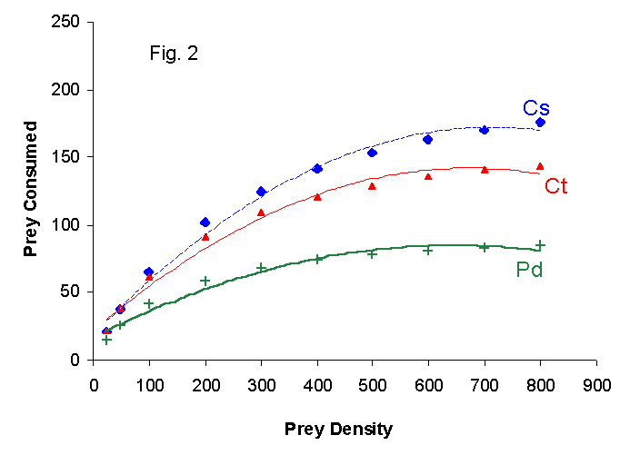
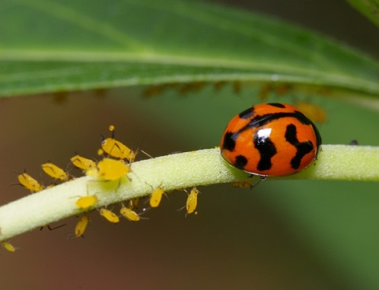
Holling (II) functional response
The number of prey caught depends on the number of prey present
The number of aphids (M. persicae) consumed in 24 hrs by 3 different ladybird species (C. sexmaculatus, C. transversalis and P. dissecta) as a function of aphid density. From Pervez and Omkar, J.Insect Science 5:5 (2005)
Notes:
The handling time for Cs is estimated to be 5.15 minutes.

Slide 47
Holling (II) functional response
The Holling (II) functional response assumes the predator on average has a constant time to handle prey
The functional response then takes the form
The handling time is h
Note that if h=0 this reduces to αV, which is what we had before
Notes:
Derivation: total time budget of predator per prey: h+1/aV

Slide 48
Holling (II) functional response
The number of prey caught depends on the number of prey present
Nr of prey caught per predator
Prey density

Slide 49
Holling (II) functional response
If we include this in the model, solutions look like this
A limit on the number of prey eaten per unit of time acts destabilising

Slide 50
The Rosenzweig-McArthur model
The model with a prey carrying capacity and the type II functional response is known as the Rosenzweig-McArthur model:

Slide 51
Stable limit cycle
If prey density dependence and a Holling type II functional response is combined it can lead to sustained oscillations
These oscillations are independent of the initial conditions
This is called a stable limit cycle

Slide 52
Stable limit cycle

Slide 53
Practical 3: Investigate the dynamics of the Rosenzweig-McArthur model.

Slide 54
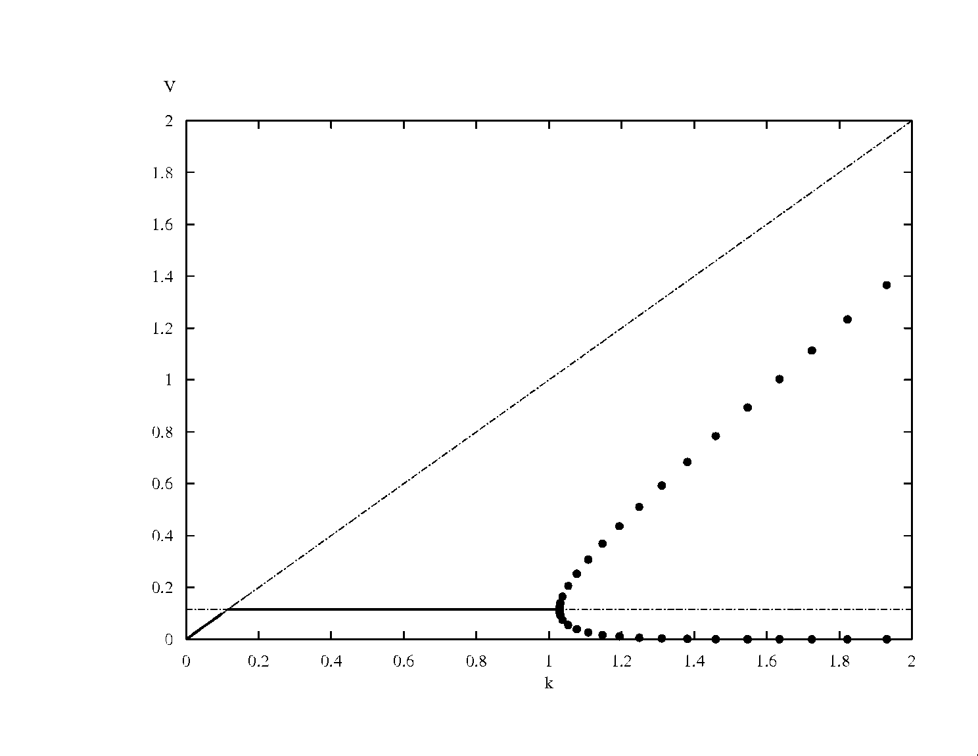
The Hopf bifurcation
V
Prey density
k
In a Hopf bifurcation, the real part of a pair of complex eigenvalues becomes positive. It results in a limit cycle.

Slide 55
The paradox of enrichment
V
Prey density
k
The paradox of enrichment: the better the environment for the prey, the worse they do.

Slide 56
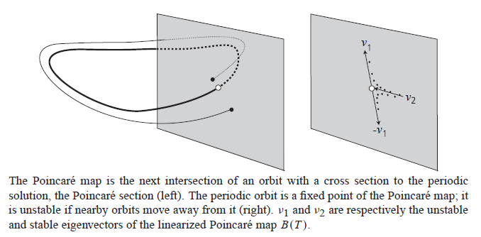
How do they do that?

Slide 57
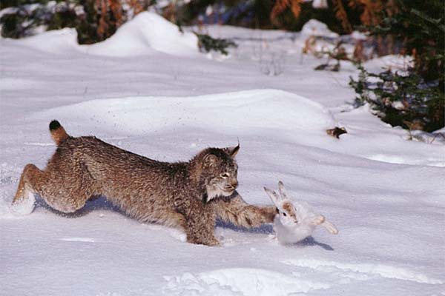
Predators and their prey
Lynx and
Snowshoe hare
Some predator and prey population show this cyclic behaviour

Slide 58

The Hudson’s Bay Company traded in pelts, and kept immaculate records

Slide 59
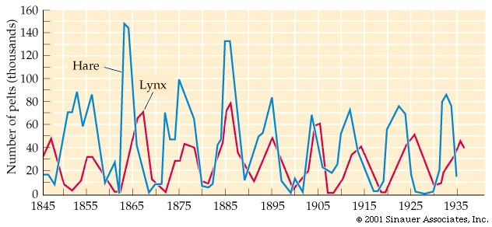
Predators and their prey
Nr of hare and lynx pelts traded through the Hudson’s Bay Company

Slide 60
Experimental demonstration
Mathematical model predicting the dynamics of a rotifer feeding on algae.
Fussman et al. Science (2000).
Notes:
Fussman GF, Ellner SP, Shertzer KW & Hairston NG (2000) Crossing the Hopf Bifurcation in a Live Predator-Prey System, Science, 290. 1358-1360

Slide 61
Experimental demonstration

Slide 62
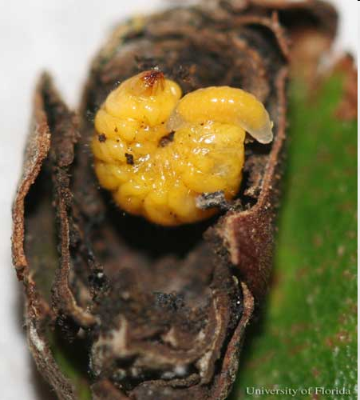
Parasitism
Parasitoids have a free living adult stage, mostly they lay their eggs on or near the host, and consume them
Parasitoid wasps often have non-overlapping generations
This introduces a delay in the interaction between hosts and parasitoid
Notes:
Mature larva of Homoeolabus analis (Illiger), a leaf-rolling weevil, with eulophid external parasitoid larva (probably Paracrias huberi Gumovsky).

Slide 63
Parasitism
Nicholson and Bailey (1935) developed a simple model for host-parasitoid interactions
Hosts are discovered by parasitoids. The more parasitoids there are, the larger the probability to be discovered.

Slide 64
Parasitism
All hosts that are parasitised give rise to one new parasitoid
Nr of new parasitoids: nr of hosts times probability of being parasitised
All hosts that are not parasitised lay λ eggs and give rise to λ new hosts

Slide 65
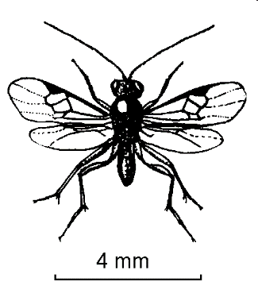

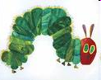

Slide 67
Parasitism
In the Nicholson-Bailey model the probability to be discovered is 1-e^{-aPt}
This assumes random searching and is derived from the Poisson distribution
The number of parasitoids in the next generation is the number of hosts in the previous generation times the probability to be discovered by a parasitoid:
P_{t+1}=H_{t}(1-e^{-aPt})

Slide 68
Parasitism
The number of hosts in the next generation is the number of hosts in the previous that were not discovered
This probability is e^{-aPt}
Each surviving host produces λ offspring
H_{t+1}=λH_{t}e^{-aPt}

Slide 69
Parasitism
The Nicholson Bailey model reads:
P_{t+1}=H_{t}(1-e^{-aPt})
H_{t+1}= λ H_{t}e^{-aPt}

Slide 70
Parasitism
Delays destabilise the host-parasitoid (and predator-prey) interaction
The model can be adapted to produce cyclic dynamics

Slide 71
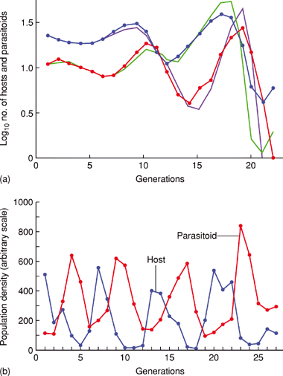
Parasitism
The population dynamics of a parasitoid and host population kept in a lab, compared to the Nicholson-Bailey model
Stable oscillations of parasitoid and host
Notes:
DOI: 10.1038/npg.els.0003164

Slide 72
Spatial interactions
Most predator-prey models are prone to produce cyclic dynamics with large oscillations that suggest that these populations are likely suffer to extinction

Slide 73
Spatial interactions
A number of natural predator-prey systems that show sustained oscillations have been found
Some examples: the hare-lynx cycle, grouse cycles, the cyclic dynamics of rodents in Scandinavia, moose-wolves on Isle Royal, several insect populations, etc.
Notes:
Some examples: the hare-lynx cycle, grouse cycles, the cyclic dynamics of rodents in Scandinavia, moose-wolves on Isle Royal, several insect populations, etc.

Slide 74
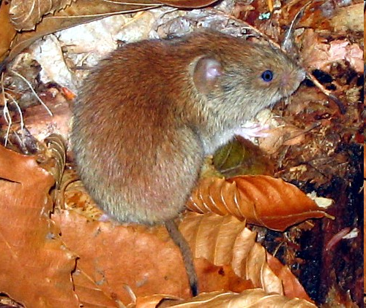
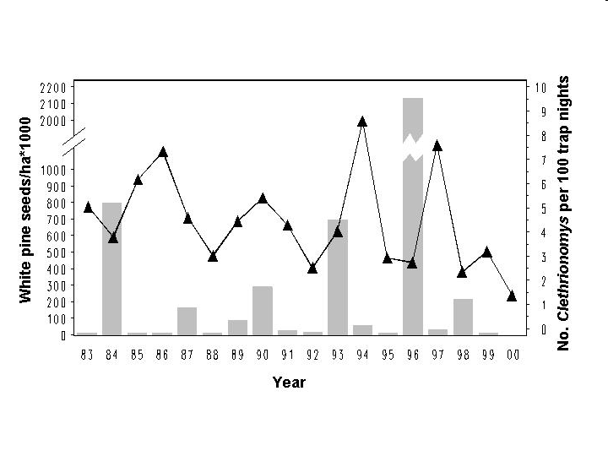
Red backed voles in Holt forest
Notes:
Red-backed voles (Clethrionomys gapperi) demonstrated a 3.6-year cycle. Abundance increased following three of four large white pine seed crops, leaving some doubt as to whether the white pine seed-vole connection was spurious or biologically meaningful. Regardless, cycling and density-dependence in Holt voles is consistent that found in vole populations in Scandinavia (Bj�rnstad et al. 1995) and elsewhere.

Slide 75
Predators and their prey
Most predator and prey populations do not show such fluctuations in the wild

Slide 76
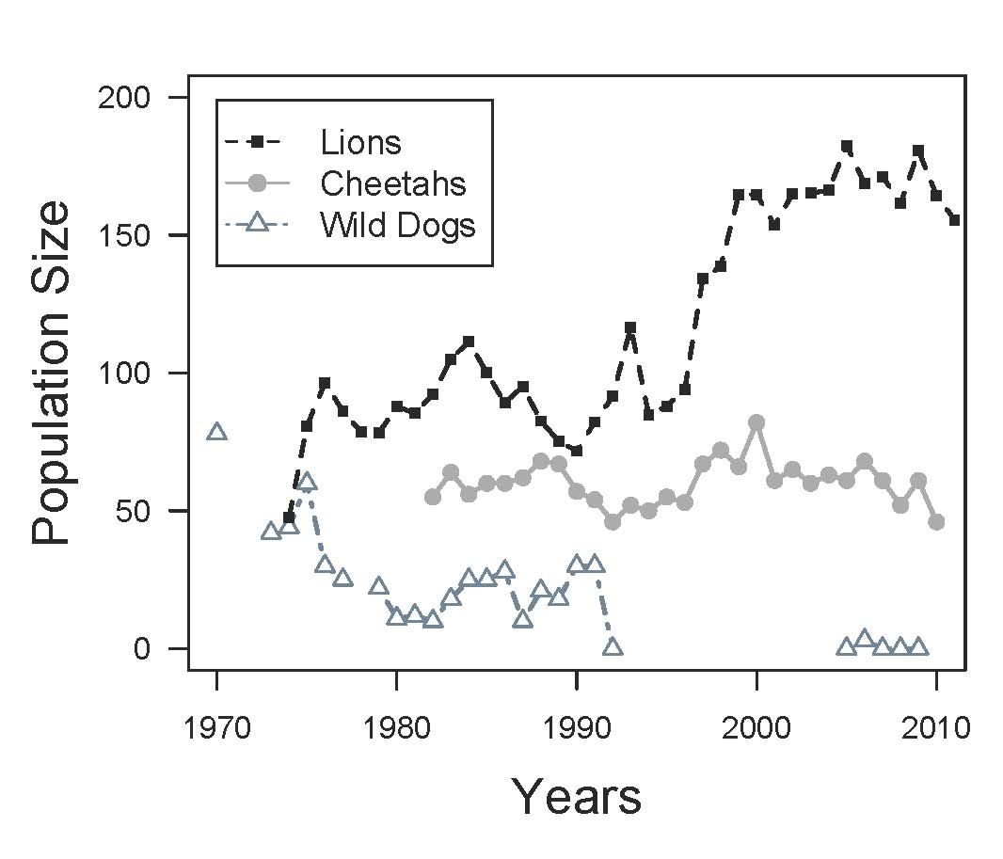
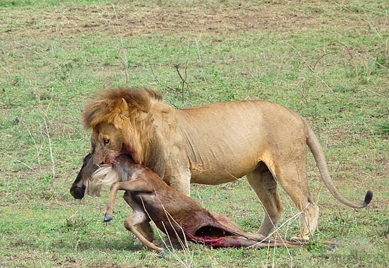
Predators in the Serengeti

Slide 77
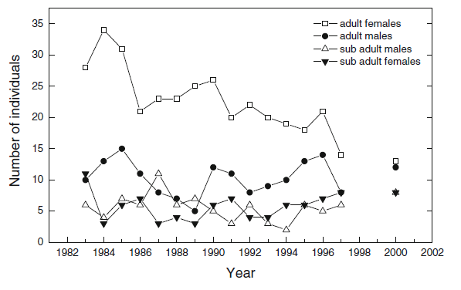
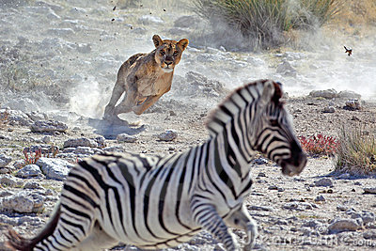
Lions in Etosha (SA)
Trinkel, Naturwissenschaften 2013
Notes:
Fig. 6 The total number of adult females, adult males, subadult males
and subadult females in central Etosha between 1983 and 1997. The
total number of lions and the number of subadults and adults in 2000
were determined by A. Burger, T. Burger and C. DuPlessis
Trinkel Naturwissenschaften (2013) 100:345

Slide 78
Predators and their prey
Most predator and prey populations do not show such fluctuations in the wild
In the lab populations many populations do show strong fluctuations and are difficult to keep alive

Slide 79
Spatial interactions
Why the discrepancy?
Nicholson and Bailey (1934) conjectured, after observing that populations do not persist in their model that populations can locally go extinct, but that other ones will start elsewhere
Can spatial interactions lead to persistence?

Slide 80
Stable limit cycle
A closer look at the hare-lynx cycle

Slide 81
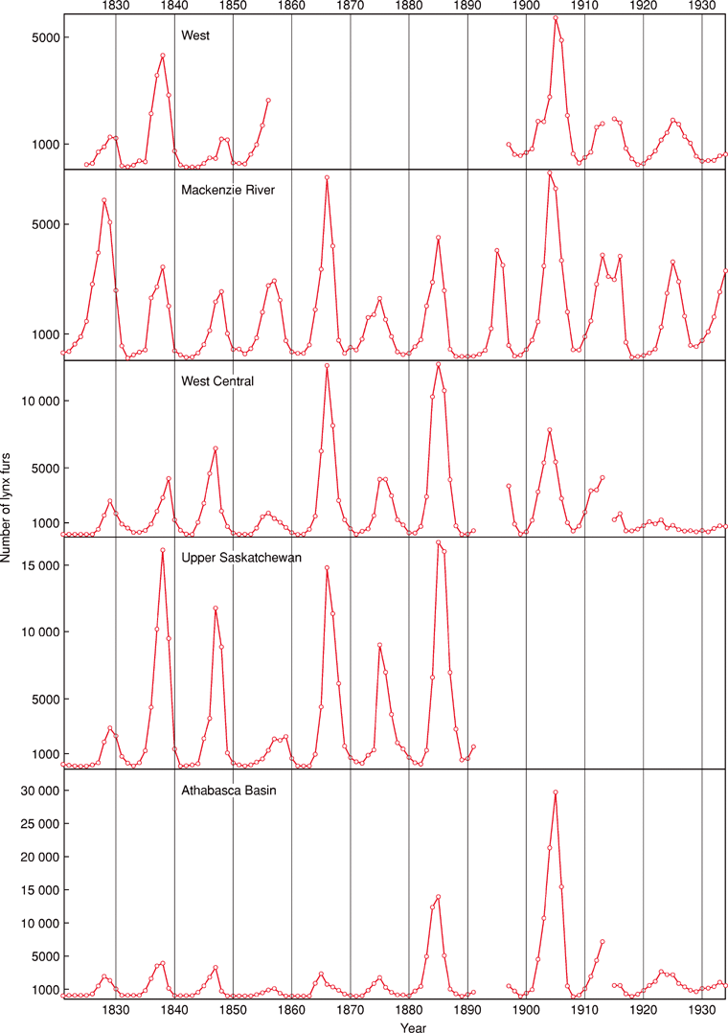
Spatial interactions
Cycles in the number of lynx fur returns of the Hudson's Bay Company, from 1821 to 1934, grouped into five regions. Note the different scales
From: M. Gillman: Population Dynamics: Introduction. DOI: 10.1038/npg.els.0003164. Original source: Elton and M. Nicholson, 1942
Notes:
Figure 9. Cycles in the number of lynx fur returns of the Hudson's Bay Company, from 1821 to 1934, grouped into five regions. Note the different scales (original source Elton and Nicholson, 1942).

Slide 82
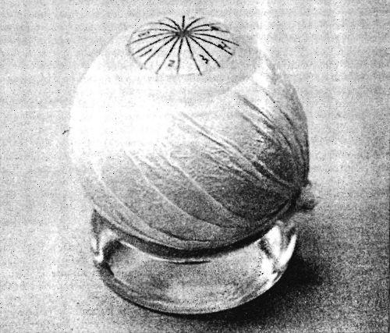
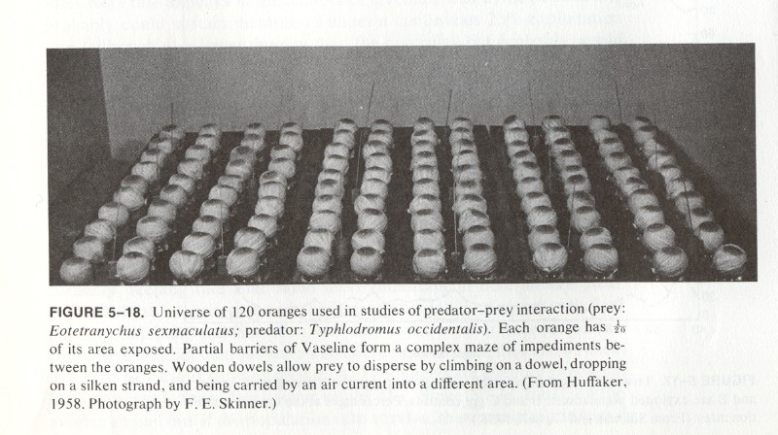
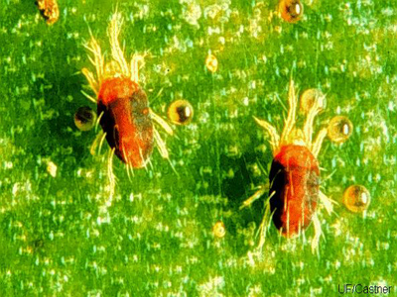
Spatial interactions
Huffaker’s mites

Slide 83
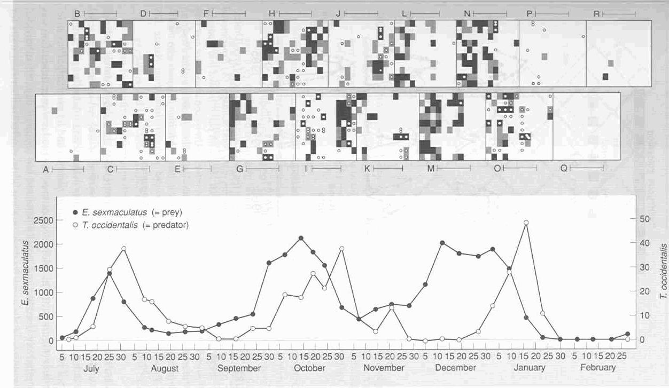
Spatial interactions
Huffaker’s mites

Slide 84

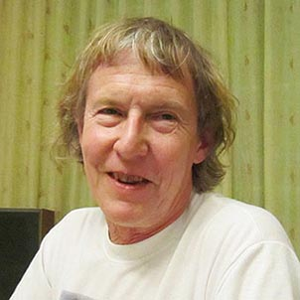
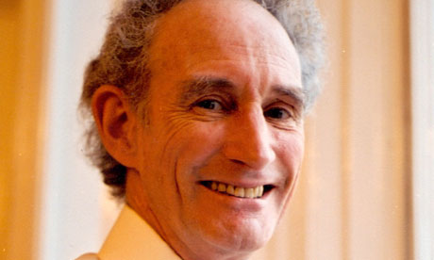
Spatial interactions
Hassell, Comins and May (1991) made a model in which they assumed that the local interactions were given by the Nicholson-Bailey model, but hosts and parasitoids could disperse to neighbouring sites

Slide 85
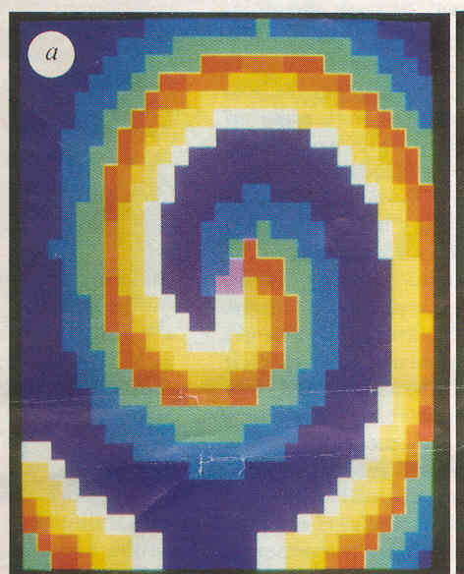
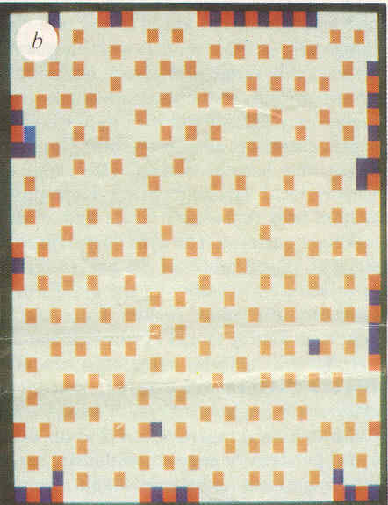
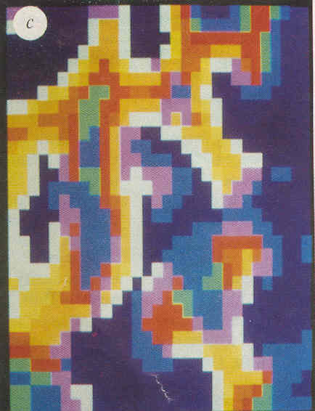
Spatial interactions
Hassell, Comins and May’s simulation results. Different colours represent different densities

Slide 86
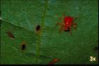
Spatial interactions
A similar pattern can occur in coupled predator-prey models
The model equations are very much like two coupled pendulums
dispersal
Space 1
Space 2

Slide 87
Spatial interactions
A similar pattern can occur in coupled predator-prey models
The model equations are very much like two coupled pendulums
dispersal
Space 1
Space 2

Slide 88
Video 2 coupled pendulums here

Slide 89
Exercise
Practical 3: The effect of space on the dynamics of a predator-prey model.

Slide 90
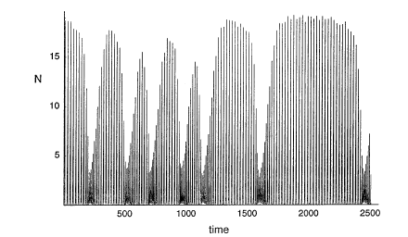
Spatial interactions

Slide 91
Spatial interactions
This offers a solution to the paradox of enrichment
One patch
ln(v₁+v₂)
k
Two patches
ln(v₁+v₂)
k

Slide 92
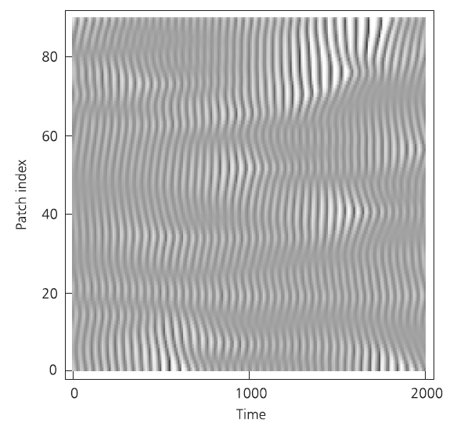
With many patches:

Slide 93
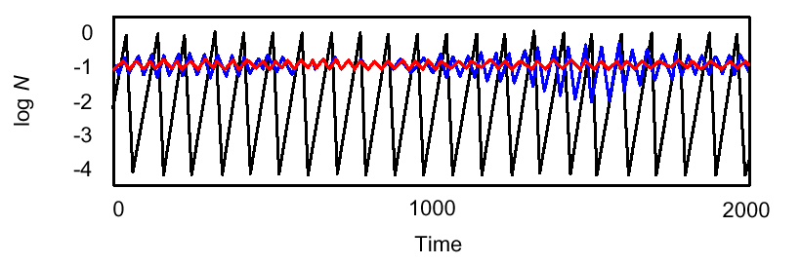
Predators and prey in space
The isolated, coupled and mean dynamics:
In a spatial system predator and prey populations do not oscillate as much and are less likely to become extinct

Slide 94
Spatial interactions
This suggests that spatial interactions can make the host parasitoid (predator-prey) system to persist
But does it really work?

Slide 95
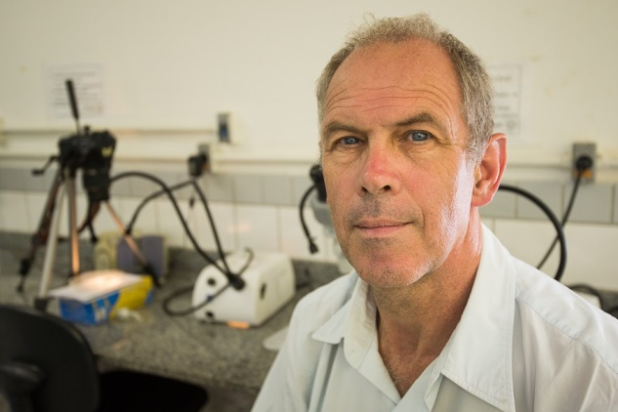
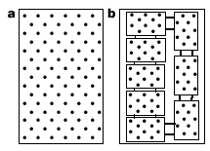
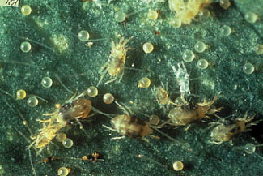
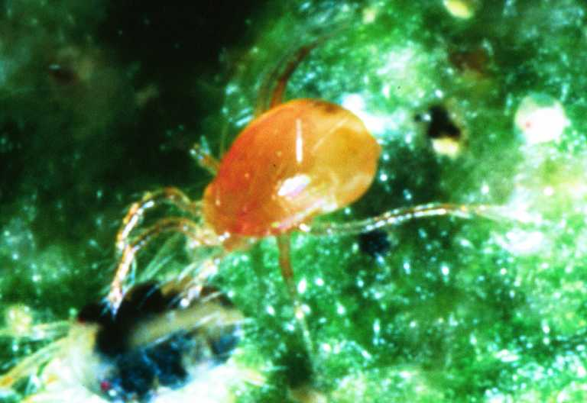
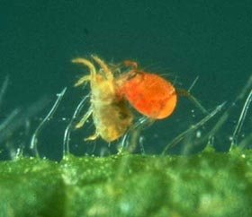
Spatial interactions
Description of Janssen’s experiment
Notes:
Tetranychus urticae and Phytoseiulus persimilis

Slide 96
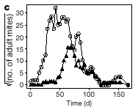
Spatial interactions
Result in the single island system

Slide 97
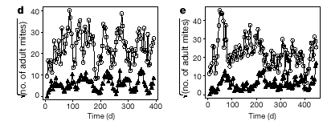
Spatial interactions
Result in the coupled islands system

Slide 98
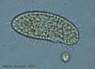
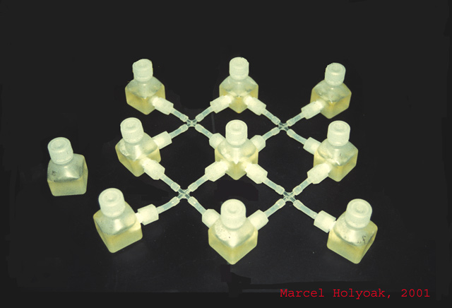

Spatial interactions
Another example:
In the array predator and prey populations persist for much longer than in a single jar (Holyoak and Lawler)
Prey: Colpidium
striatum
Predator: Didinium nastutum

Slide 99
Phase locking
But not all coupled systems will show this pattern
Another possibility is phase locking: the two patches will cycle in synchrony (also easily produced in the coupled pendulums)

Slide 100



Phase locking
Tetrahymena pyriformis
Euplotes patella
DA Vasseur & JW Fox Nature 000, 1-4 (2009) doi:10.1038/nature08208
Notes:
a–f, Results from pairs of jars experiencing the Moran effect and dispersal (a, d), predators (b, e), or predators and dispersal (c, f) are shown. Panels a–c give illustrative dynamics from our theoretical model, and d–f give illustrative dynamics from our experimental microcosms. Adding predators to the theoretical model and experimental Tetrahymena cultures generates cyclic dynamics. In the presence of dispersal, cyclic dynamics are entrained by phase-locking. Across panels a–c the same initial conditions and stochastic perturbations were used to highlight the effect of predators and dispersal.
METHODS:
We conducted a fully crossed factorial experiment on the effect of dispersal, the Moran effect and predators on the synchrony of T. pyriformis dynamics in paired culture jars. Dispersal was accomplished by manual transfer of 10% of the experimental medium three times per week. We randomly varied the incubation temperature of culture jars on a daily basis between 20 and 30 °C according to prescribed schedules. Paired jars receiving the Moran effect experienced identical variability, whereas the remainder experienced independent variability. The predator treatment consisted of the addition of 15 individuals of E. patella to each jar in a pair on day 3 of the experiment. Each of the eight treatment combinations were replicated six times for a total of forty-eight experimental units. Tetrahymena and Euplotes densities were sampled each weekday using published methods30, until day 64 of the experiment. We calculated the Pearson correlation of the first-order differences of Tetrahymena and Euplotes densities and conducted ANOVAs on the Fisher's z-transformed correlations.

Slide 101
Learning outcomes
Understand the logic underlying the Lotka-Volterra predator model and its limitations
Appreciate the effects of prey density dependence, functional responses, time delays and spatial structure

